Slide 1
Axiom Housing Association Kate Wood
Developing Support for Young People at Risk of Homelessness

Slide 2
Introduction
Axiom Housing Association
Will have been in existence 50 years in 2017
Runs across a cradle to grave service in several sectors
Active in the East of England across Cambridgeshire, Lincolnshire, and Leicestershire.

Slide 3
Homelessness in Lincolnshire
Axiom is part of the consortia of the Lincolnshire Safer Partnership
We hold all of the youth homelessness bed spaces in Lincolnshire
Access under 18 is through the single gateway run by childrens services
Over 18 is through the Avenue.

Slide 4
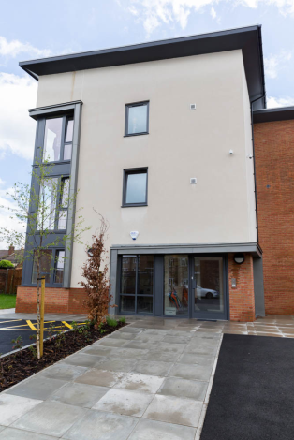
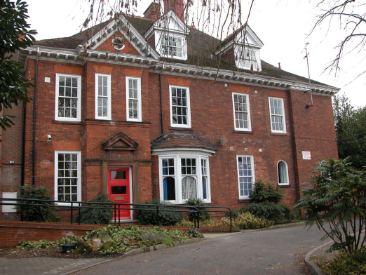
A bit about Me!
Interim Service Manager for Gainsborough Foyer and Market Rasen House
Email kate.wood@axiomha.org.uk

Slide 5
What is Youth Homelessness?
Youth homelessness is defined as young people under the age of 25
They have no secure accommodation to live
50% of all people seeking help for homelessness are under 25.
Fewer than 50% are rough sleeping leading to a high proportion of hidden homelessness.

Slide 6
Causes of Youth Homelessness
Family breakdown
Benefit cap
No longer in ETE
Inability to claim benefits in their own right under 18
Seasonal work
Hormones

Slide 7
The impact of Youth Homelessness
Direct cost to the Local District Council
Increased intervention of other agencies
Lack of employment skills and educational attainment
Lack of tenancy skills and independent living skills
Poor financial capability

Slide 8
The impact of Youth Homelessness
Poor social and emotional skills
Increase in ASB
Increase in other agency intervention
Repetition of family breakdown having an impact on more single adult households
Continued cycle of homelessness.

Slide 9
Prevention – before they become homeless
Foster links with your local schools
Develop links with Early Help Workers, FAST team, youth homeless specialists,
Community policing
MASH (Multi Agency Safeguarding Hub)
Floating support
Leaving Care

Slide 10
Prevention 2
Are they a LAC (looked after child?)
Section 20 or Section 31?
Leaving care – up to 25
Early Help Workers
TAC intervention – this can continue until their 19th birthday.

Slide 11
Types of Youth accommodation
Foyers (www.foyer.net)
Supported lodgings
Supported accommodation
Private rented (over 18 only)
Local Authority housing
Tied housing

Slide 12
Foyers
Are specifically designed for 18-25
Teach independent living skills
Residents have to be in ETE as part of their licence agreement
Residents can stay up to 12 -24 months dependant on the area and age
Usually have planned move on properties

Slide 13
Supported lodgings
Tend to only be able to be accessed by children's services, usually a looked after child.
Teach independent living skills
Residents have to leave these projects once 18 and able to move into their own tenancies.

Slide 14
Supported accommodation
Can have a much wider age range than just youth homelessness
Can be for a wider range of vulnerable people such as mental health, young families etc
Time frame varies by project and not always linked to specific move on accommodation

Slide 15
Private rented properties
Can only be accessed by those over 18
Under 35 and single are only entitled to a shared room rate under housing benefit
Doesn’t usually require a large deposit, this can sometimes be covered by the tenancy deposit guarantee scheme operated by local councils.

Slide 16
Local Authority Housing
Nationally there is a shortage of one bedroom properties
All residents now have to demonstrate a local connection to an area unless they are a care leaver
Financial capability assessments are becoming the norm before offering a tenancy

Slide 17
Tied Housing
Often found in rural areas or areas of high seasonal work
Housing is only provided as long as the work is there
Can cause the young person to be deemed intentionally homeless if they lose their job through dismissal

Slide 18
Housing Benefit
Anyone living in exempt accommodation should not be claiming Universal Credit they should be claiming income based benefits and housing benefit.
Exempt accommodation:
Exempt Accommodation is accommodation provided by a registered provider of social housing, registered charity, non- metropolitan County Council or another form of non-profit making organization where the landlord provides care, support or supervision directly or where the care, support or supervision is provided on the landlord's behalf. The Exempt Accommodation rules allow providers of such accommodation to fund additional housing management services to vulnerable tenants (provided that the costs can be properly justified)

Slide 19
Education
Many young people who find themselves homeless have had a poor educational background
All young people under 18 have to be in ETE
Functional maths and English can replace GCSE
Many education providers offer bursaries to those in supported housing and in receipt of Income Support

Slide 20
Education and benefits
Any young person who is involved in education more than 16 hours per week and is under 19 can claim income support.
This is the passport to other educational bursarys such as the 16-19 bursary, free school meals and free school transport.
Those over 19 can apply for an adult learning grant, many further education institutions will waive their tuition fees, provided it is a level 3 course or below.

Slide 21
Other types of ETE
Traineeships
Apprenticeships
Employability skills
Princes Trust
Volunteering more than 20 hours a week (passports you to income support)

Slide 22
Benefit issues
Lack of forms of ID
Difficulty opening basic bank accounts
Limited Post Office Accounts
Simple payments
Learning Agreements and breaks in agreements

Slide 23
Move on plans
ASB and young people
Utilising ABC contracts with community policing and YoT
Positive and planned move on
Proving tenancy and independent living skills
http://moveoncourse.org.uk/course-modules/
Diminishing levels of support

Slide 24
Mental Health and drug /alcohol issues
14.56 Where patients are subject to the short-term effects of alcohol or drugs (whether prescribed or self-administered) which make interviewing them difficult, the AMHP should either wait until the effects have abated before interviewing the patient or arrange to return later. If it is not realistic to wait because of the patient’s disturbed behaviour and the urgency of the case, the assessment will have to be based on whatever information the AMHP can obtain from reliable sources. This should be made clear in the AMHP’s record of the assessment.” Mental Health Act 1983

Slide 25
Other agencies
Early Help – only up to 18
TAC – up to 19
YoT – up to 19 (Early intervention)
Princes Trust/Talent Match
Children's Services
Leaving Care
CAMHS

Slide 26
Other agencies 2
Adaction
Blue Light projects
Nacro
Probation
Terrance Higgins Trust
Links to change
Step change

Slide 27
Other agencies 3
Citizens Advice
Local Housing providers
Housing Options (district council)
Adult Social Care
Crisis team
Local colleges

Slide 28
Other agencies 4
Neighbourly project www.neighbourly.com
Fareshare food cloud www.fareshare.org.uk
Salvation Army
Volunteer hubs
Community Groups
Safeguarding vulnerable adults boards

Slide 29
Thank you for listening
Any questions?
Kate Wood
01427 809362

